Slide 1
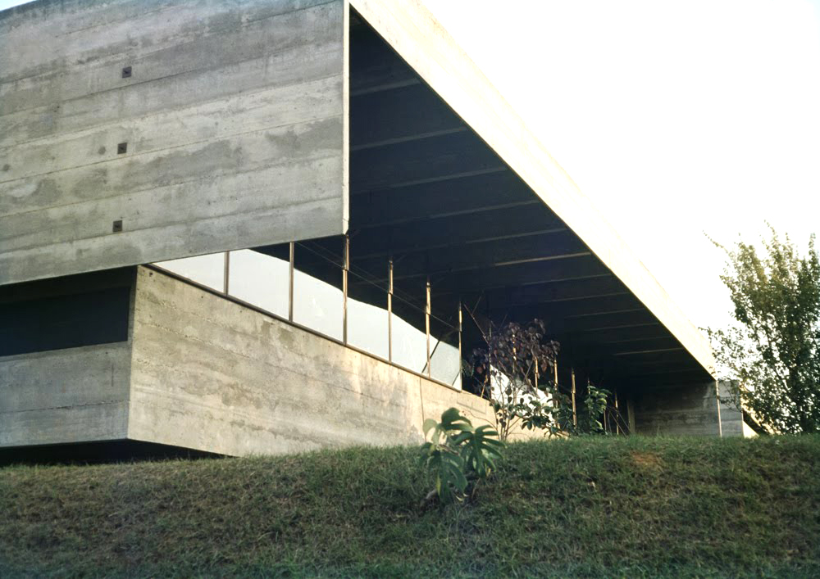
Casa Butanta
Paulo Mendes da Rocha

Slide 2
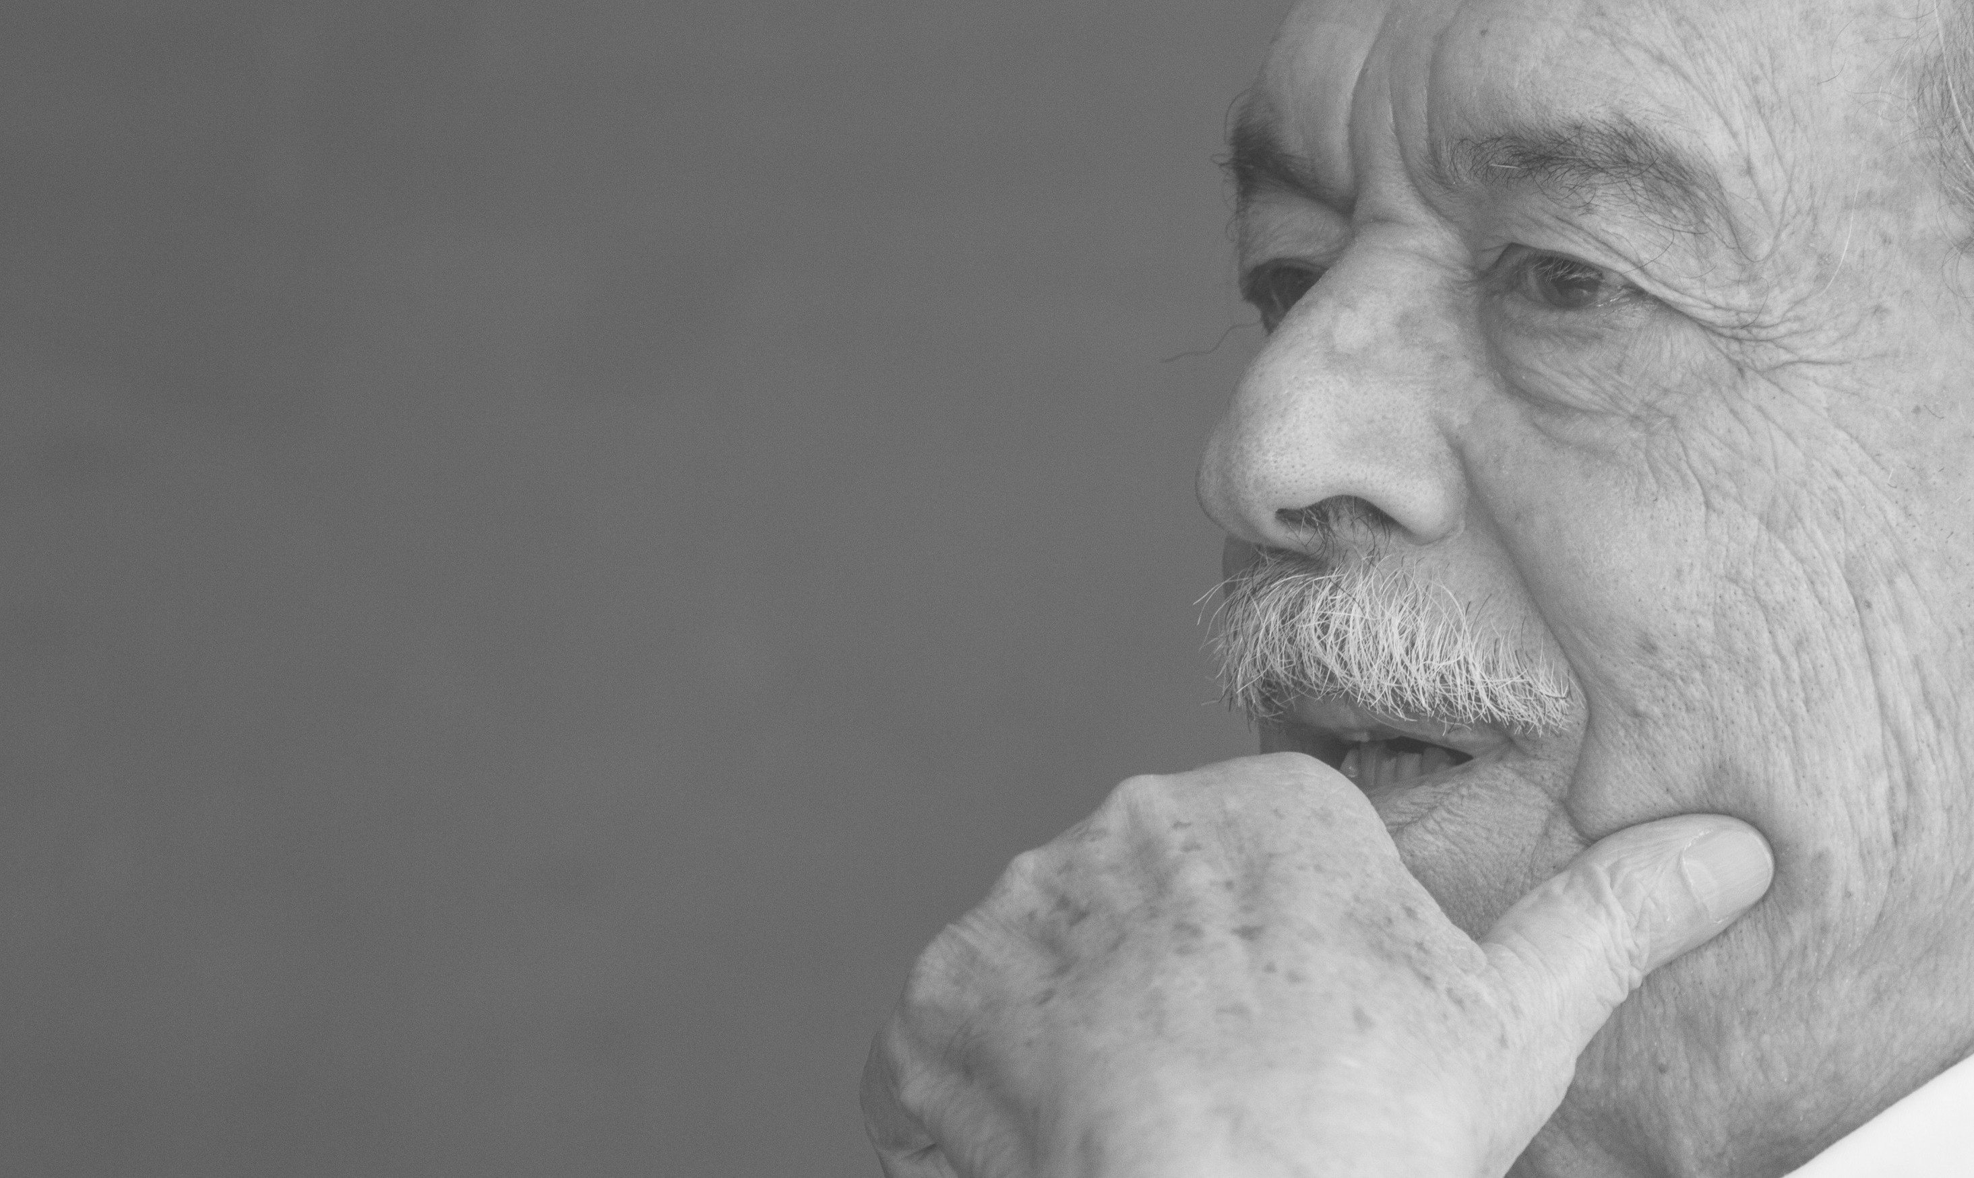
Casa Butanta
Paulo Mendes da Rocha, is a Brazilian architect. He attended the Universidade Presbiteriana Mackenzie College of Architecture,graduating in 1954.
Working almost exclusively in Brazil, Mendes da Rocha has been producing buildings since 1957, many of them built in concrete, a method some call "Brazilian Brutalism", arguably allowing buildings to be constructed cheaply and quickly. Paulo is one of the most representative architects of the Brazilian Paulista School, also known as “Paulista Brutalism” that utilizes more geometric lines, rougher finishes and bulkier massing than other Brazilian Modernists sush as Oscar Niemeyer.
Paulo Mendes da Rocha, in honored with the Mies van der Rohe Prize (2000) and the Pritzker Prize (2006).
"All space must be attached to a value, to a public dimension. There is no private space. The only private space that you can imagine is the human mind." - Paulo Mendes da Rocha, May 26, 2004

Slide 3
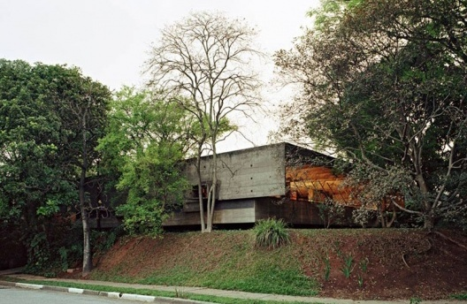
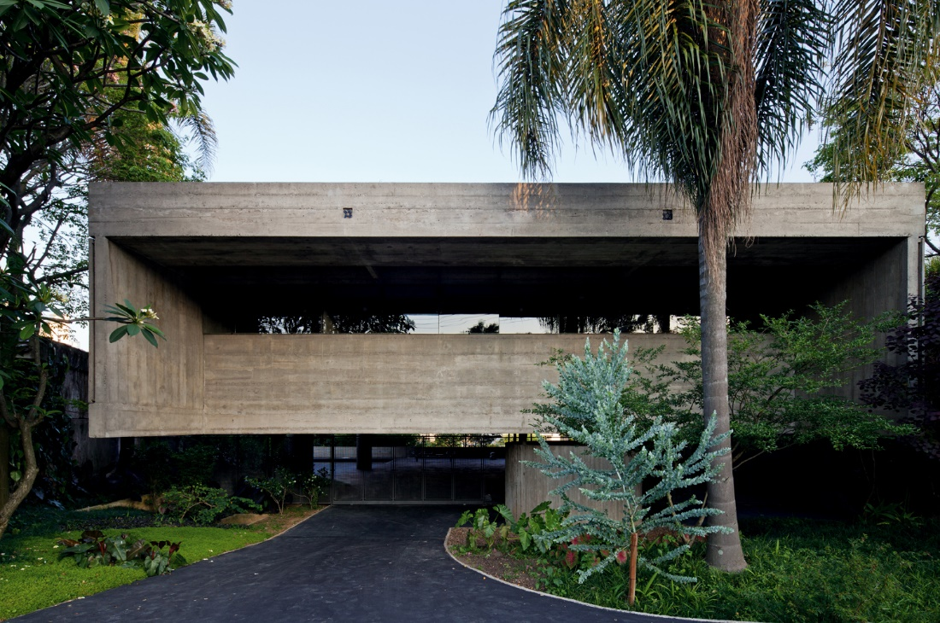
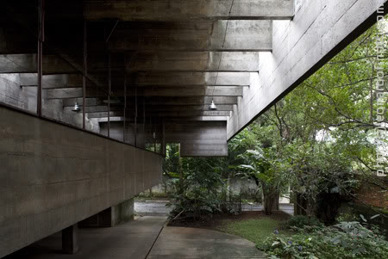
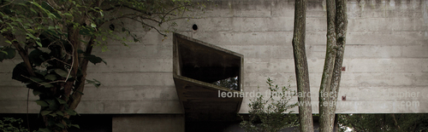
Casa Butanta

Slide 4
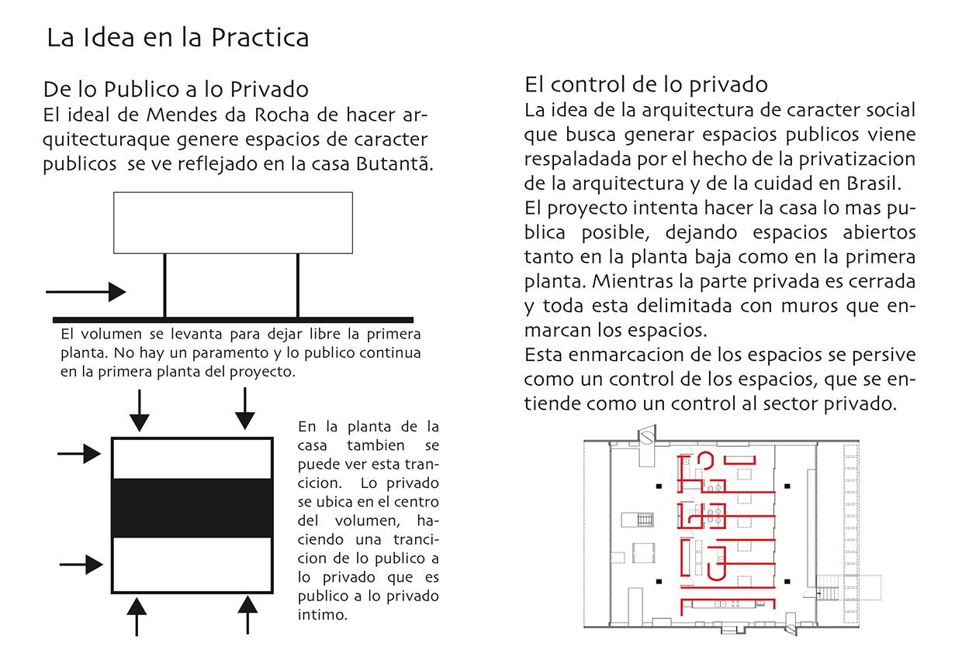
Casa Butanta
The idea in practice
From public to private
The ideal of Mendes da Rocha to make public spaces architectural generated character is reflected in the Butanta home.
The volume rises to clear the first floor. There is no public facing and continues on the first floor of the project proposal.
Control Private
The idea of social architecture that seeks to generate public spaces comes because of the privatization of the architecture and the city in Brazil.
The project tries to make the house as public as possible, leaving open spaces both on the ground floor and the first floor.
While private part is closed and all is bounded by walls that frame the spaces.
This framing spaces are persive as a control space, understood as a control to the private sector.
On the floor of the house you can also view this trancicion. Private is located in the center of the volume, making a trancicion from public to private it is public to private intimate.

Slide 5
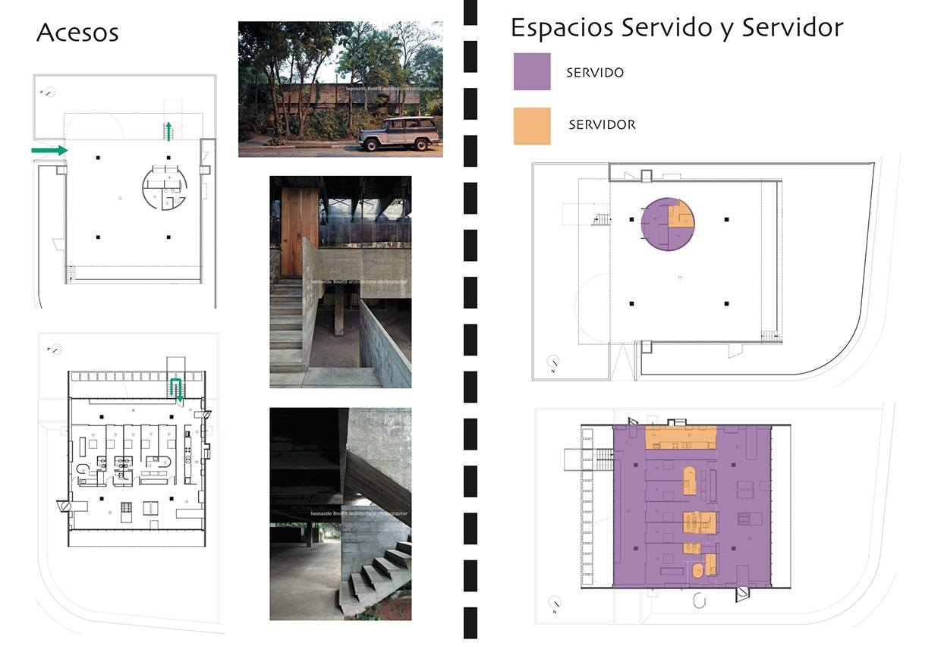
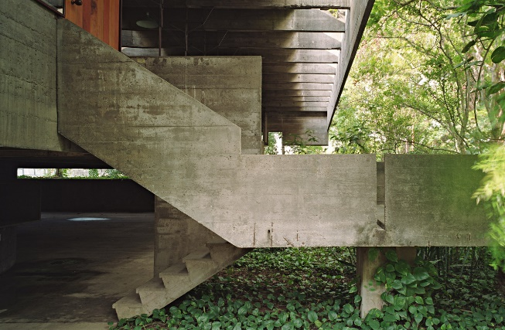
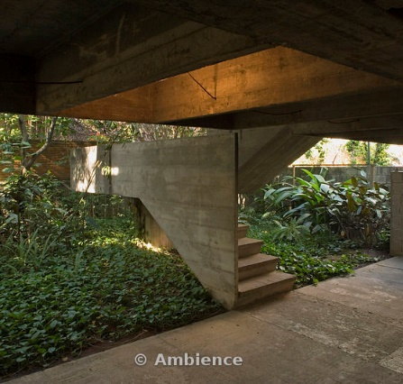
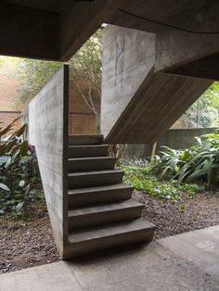
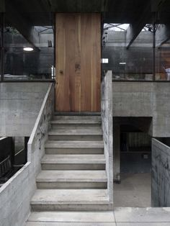
Casa Butanta
Accesses
Ground floor
First floor

Slide 6
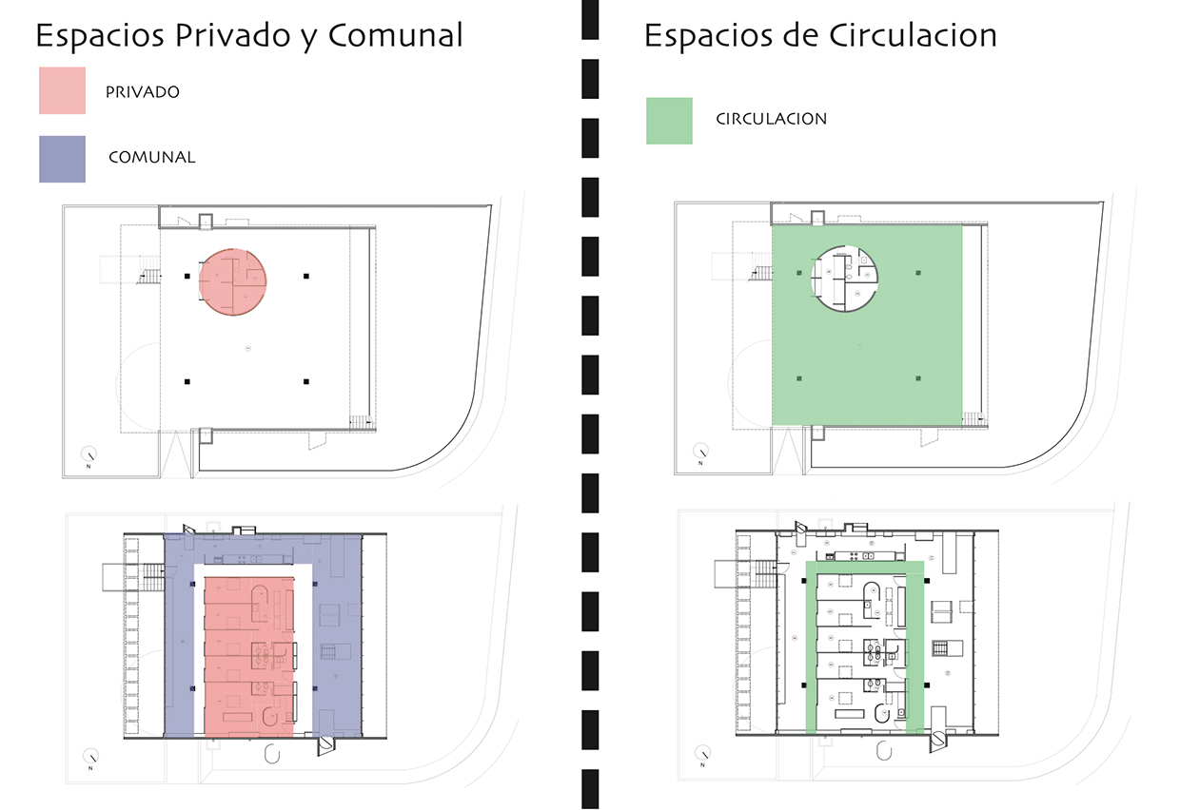
Casa Butanta
Private and Communal Spaces
Circulation Space
Private Spaces
Communal Spaces

Slide 7
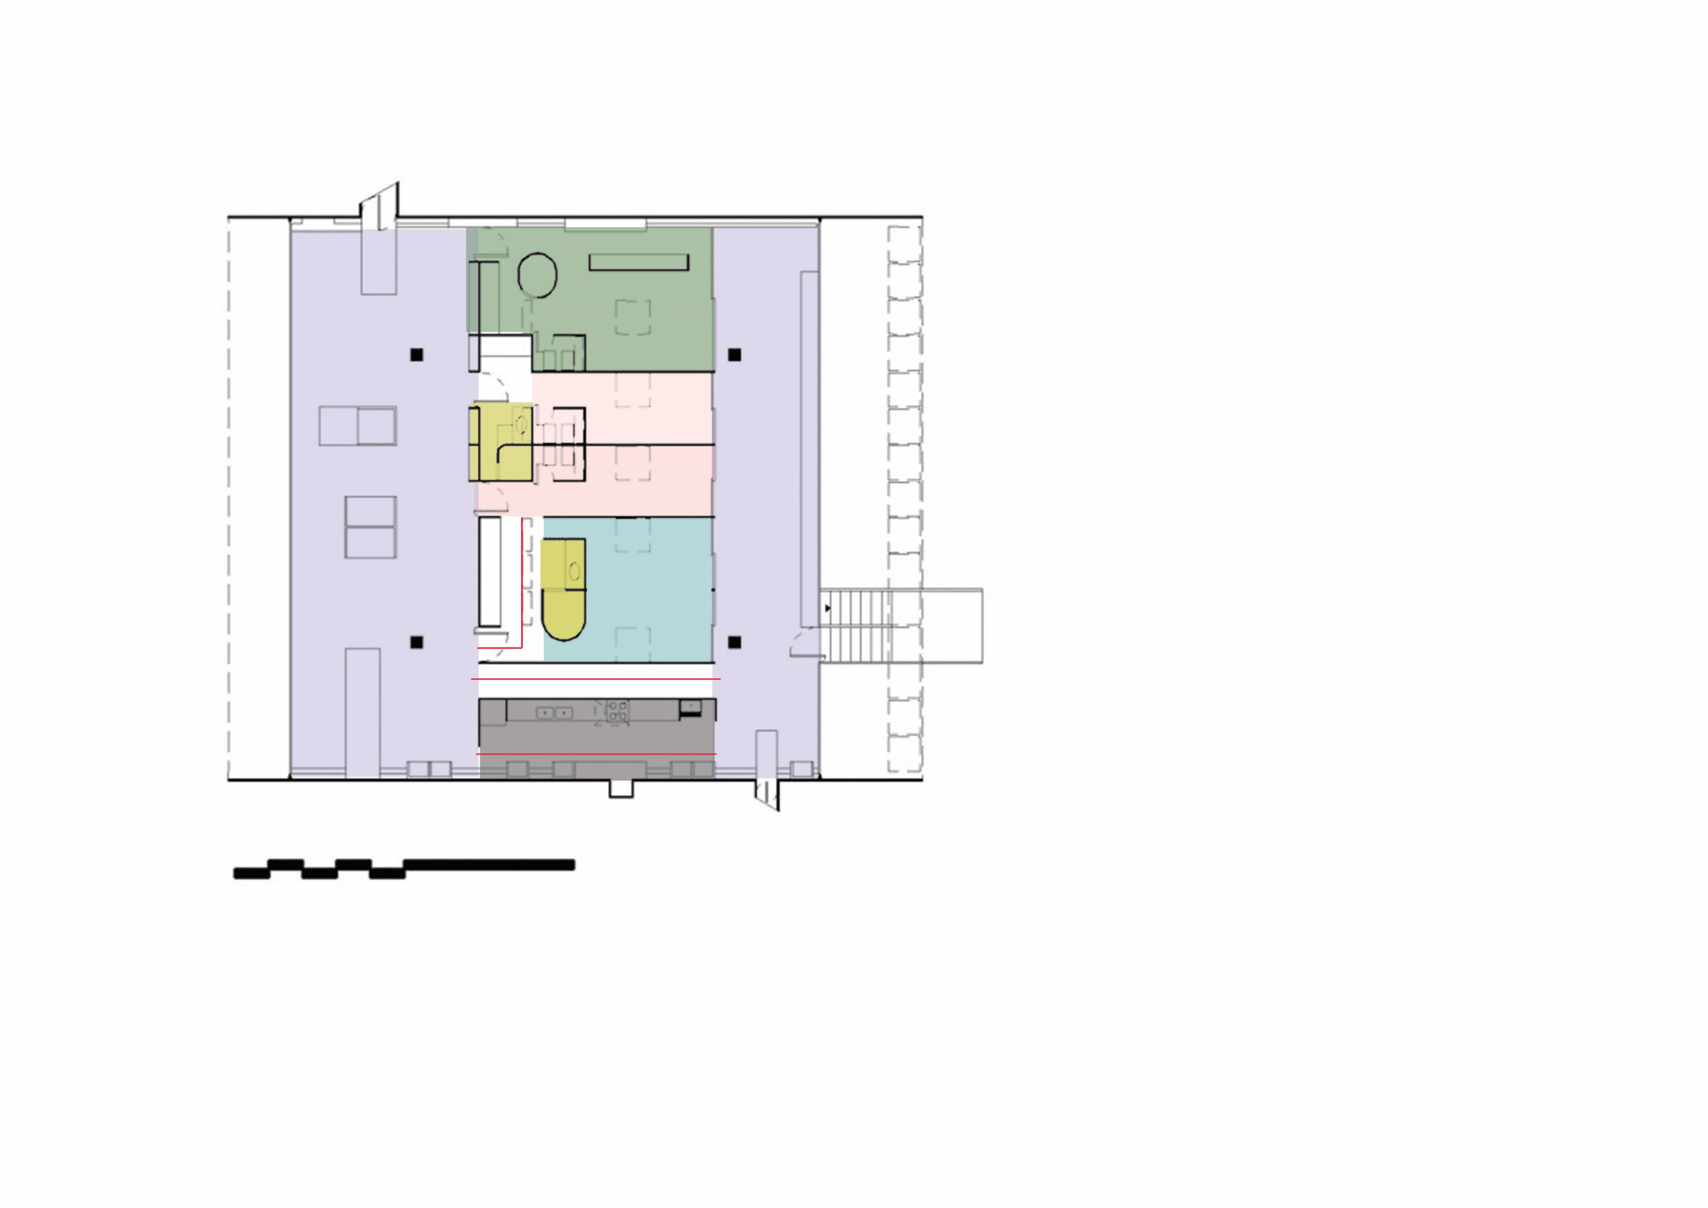
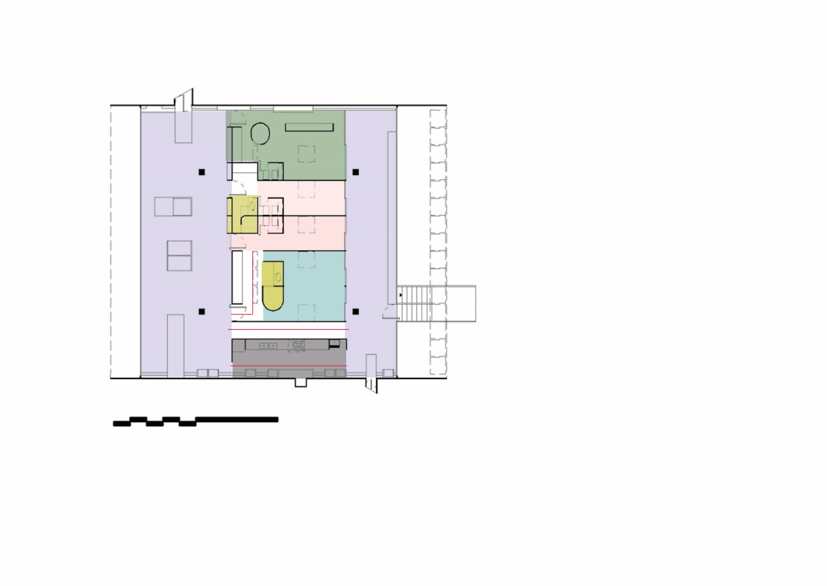
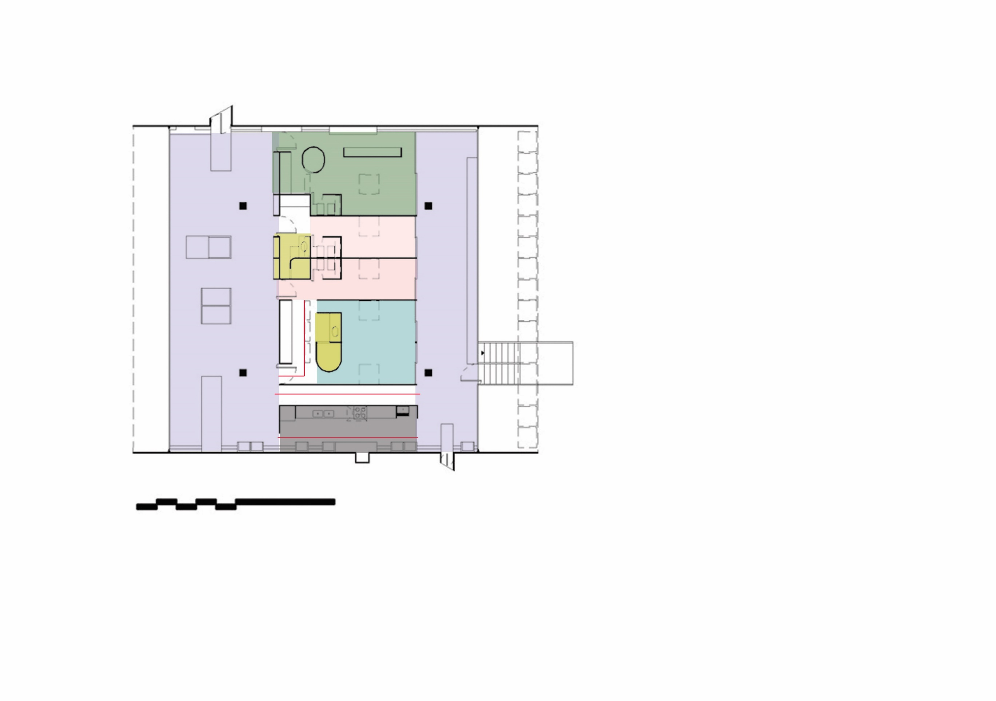
Casa Butanta
Uses of the building
N
Communal spaces
Kitchen
Master Bedroom
Kid’s Bedroom
WC
Living Room
Hallways

Slide 8
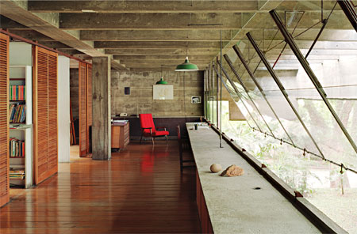
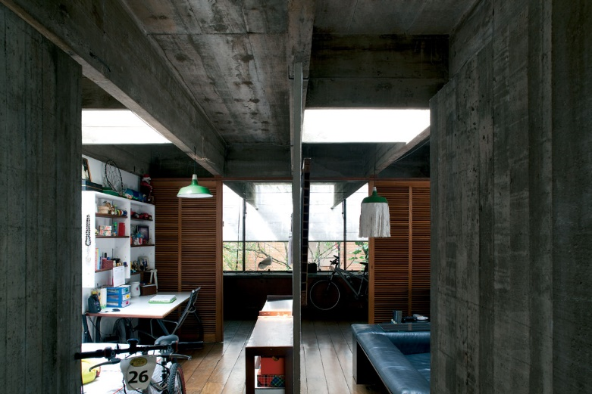
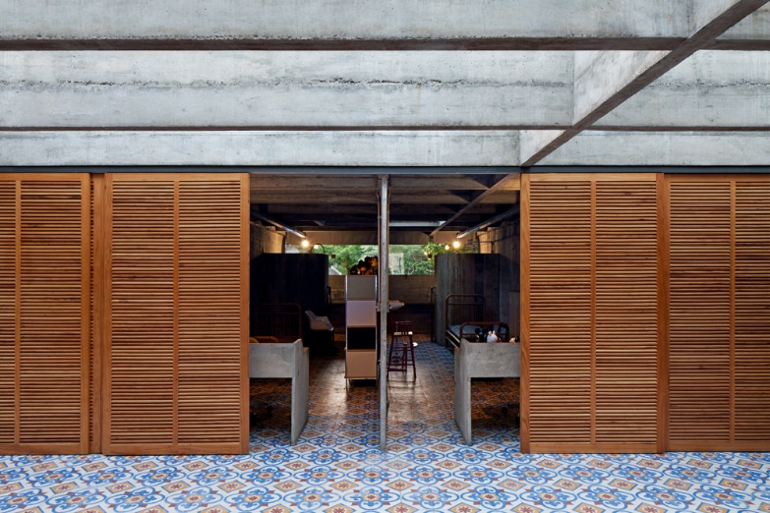
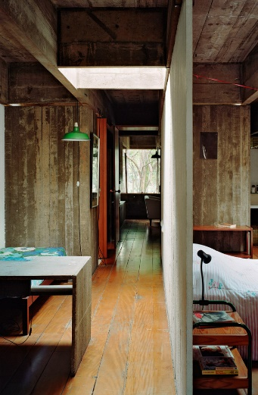
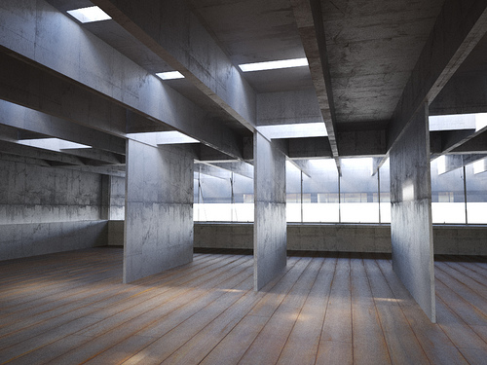
Casa Butanta
Interior
The interior of this dwelling, creates an open plan space, where all the communal activities between the users don’t have strict limits. Spaces that are more private, like bedrooms, are separated from the rest of the communal spaces with moving panels, that can be easily transform the use of the space.

Slide 9
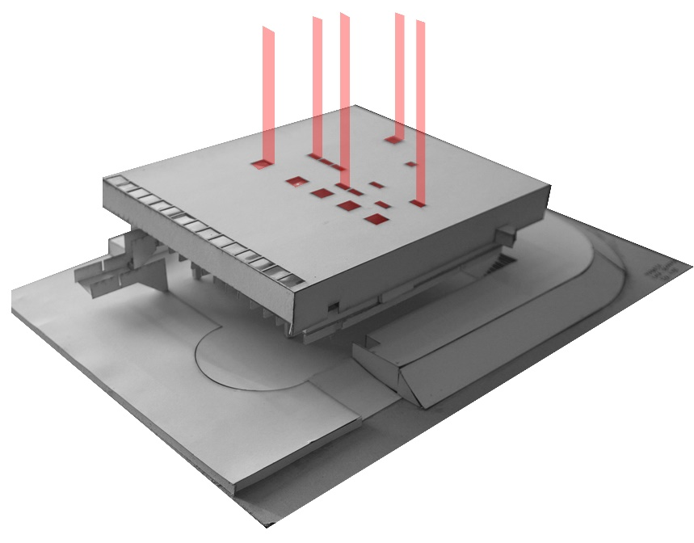
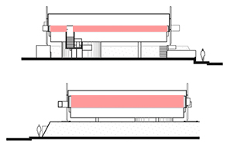
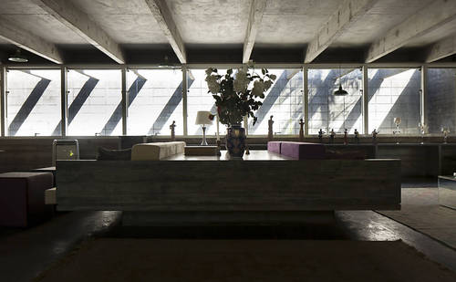
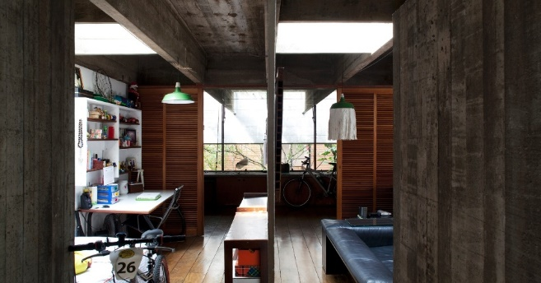
Casa Butanta
The lighting in the house runs through sales and skylights. The windows are located in this short facades and are as long as the facades.
The skylights are located on the rooms and bathrooms and there is one that is in the room.
Inside the house you can see a play of light that is generated by the spaces provided for mong light and the height of the walls.

Slide 10
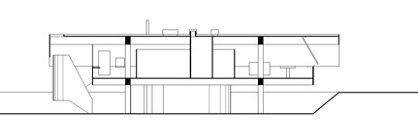
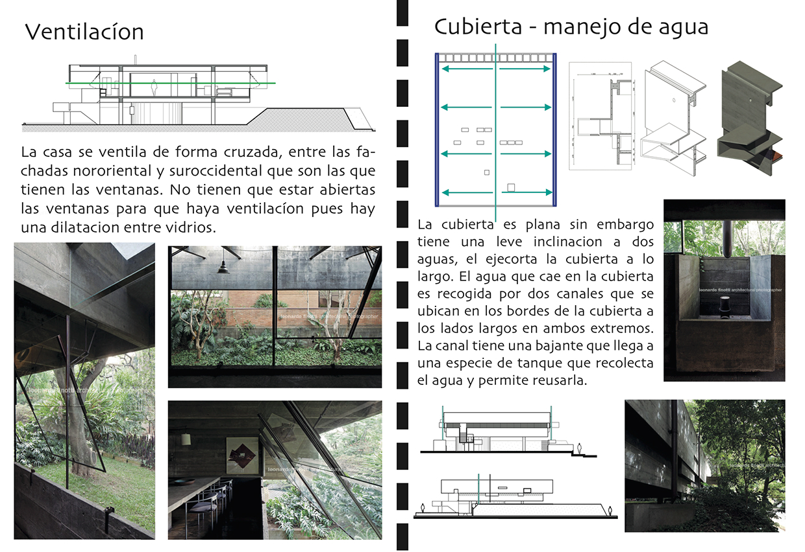
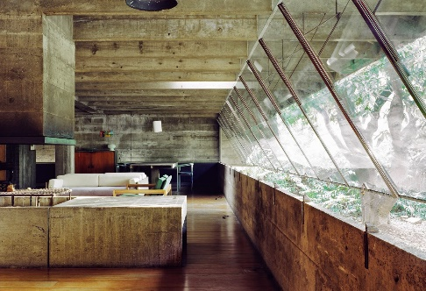

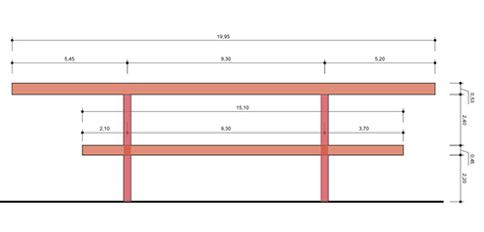
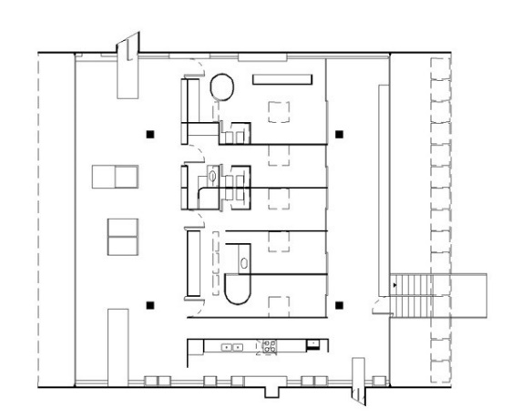
Casa Butanta
Like structure and the walls are finished in reinforced concrete.
The plates are covered by two main beams, each beam rests on two pillars. Complemented by beams that help support plates.
Ventilation
The house is ventilated crosswise between the northeastern and south facades are you have windows. No need to be open windows for ventilation because there is a dilatation between panes.

