Slide 1
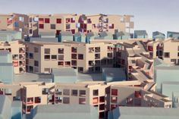
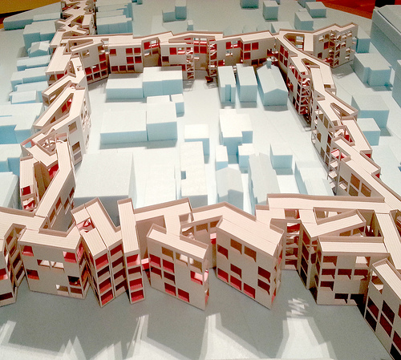
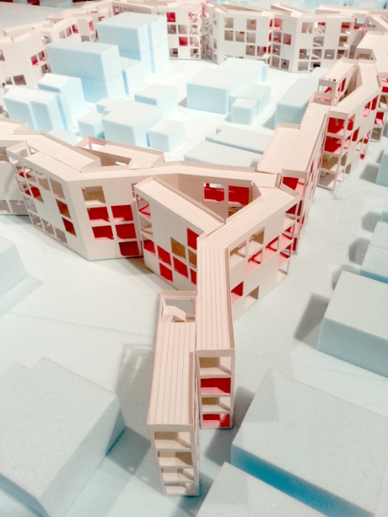
MOS-MOMA’s Foreclosed
Rehousing the American Dream
Paraskevi Komodromou, Eftychia Nastou, Maria Prodromou

Slide 2
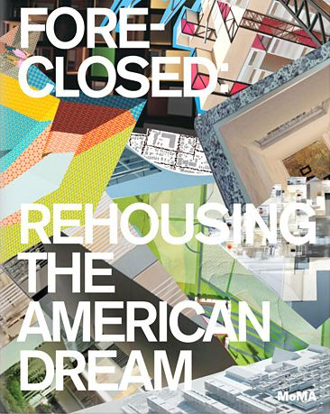
MOMA’s Foreclosed Rehousing the American Dream
Five interdisciplinary teams of architects
exploration of new architectural possibilities for cities and suburbs
focused on a specific location-megaregion
to come up with inventive solutions for the future of American suburbs

Slide 3

MOMA’s Foreclosed Rehousing the American Dream
Foreclosure might then be viewed as a framework for re-envisioning the American Dream and architecture's role in that dream

Slide 4
MOMA’s Foreclosed Rehousing the American Dream
Architect’s challenge:
To envision new housing and transportation infrastructures
To catalyze urban transformation
Rethinking the relationship between land, housing, infrastructures and urban form

Slide 5
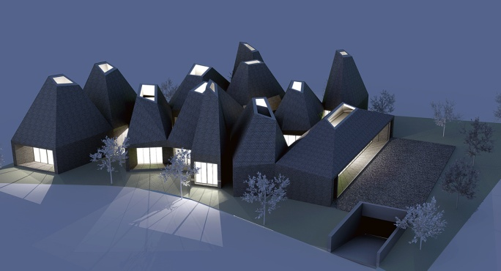
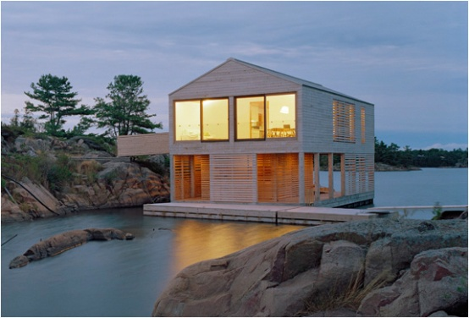
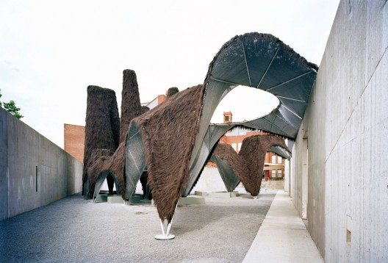
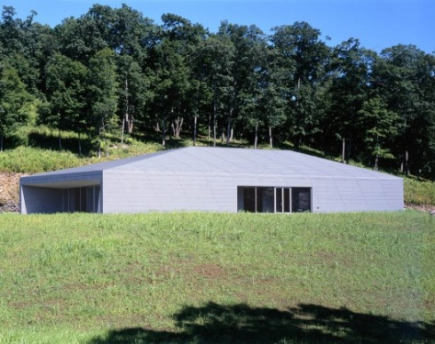
MOS Architects
Practice and design through:
an inclusive methodology of research
expansive collaboration and
extensive experimentation
a unique set of parameters, specific to its condition
Different scales- from product design to urban infrastructure

Slide 6
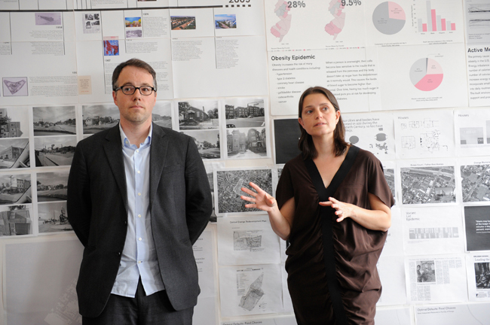
MOS MOMA’s Foreclosed,
Thoughts on a Walking City
Architecture team: led by Michael Meredith and Hilary Sample of MOS
Located: Orange, New Jersey
Type of project: "Transit Villages," consisting of mixed-use development

Slide 7
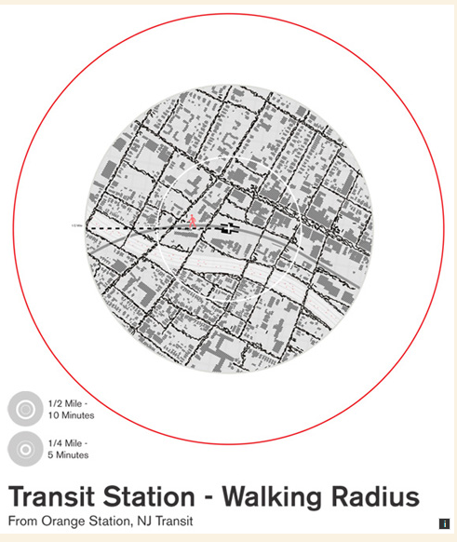
The Orange
15% of the land is composed of municipal buildings and vacant land
22% is composed of public streets and sidewalks in a traditional gridded plan

Slide 8
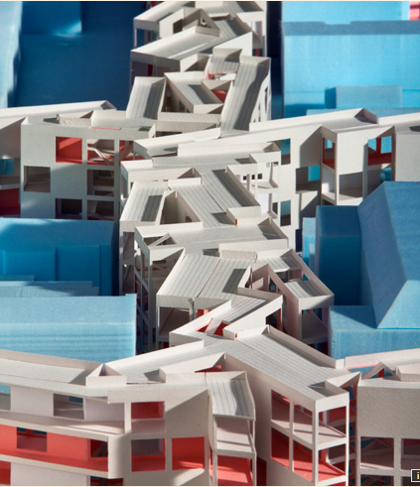
Team’s Proposal
Eliminates many of these streets
Replaces them with three-story structures with a mixture of commercial, office, and residential spaces, including a variety of live-work spaces

Slide 9
MOS- Thoughts on a Walking City
These new ribbons of building are in part developed as public housing
New and old structures coexist
Streets of traditional single-family houses are juxtaposed with the new ribbon development
A rich variety of spaces and relationships is created, including ground-floor shops and services and upper floors that are mixed live-work conditions
Pedestrian experience is primary in the overall development of this once vibrant suburb

Slide 10
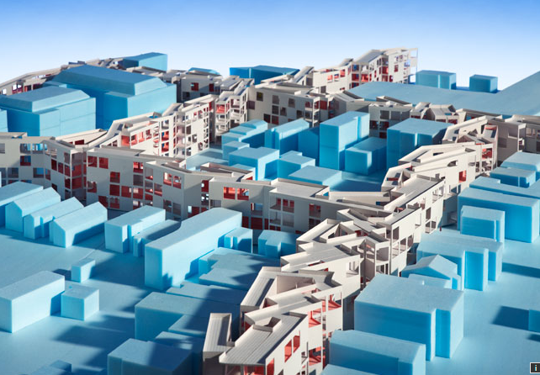
Architectural model, showing the mixed-use development between existing houses and industrial buildings

Slide 11
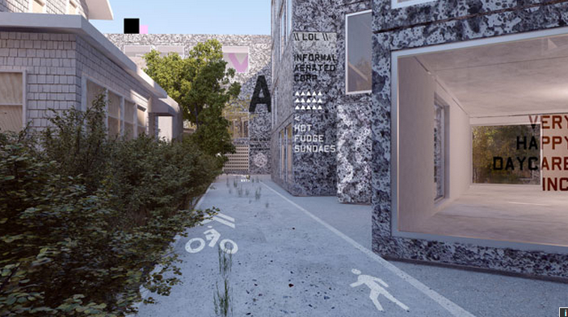
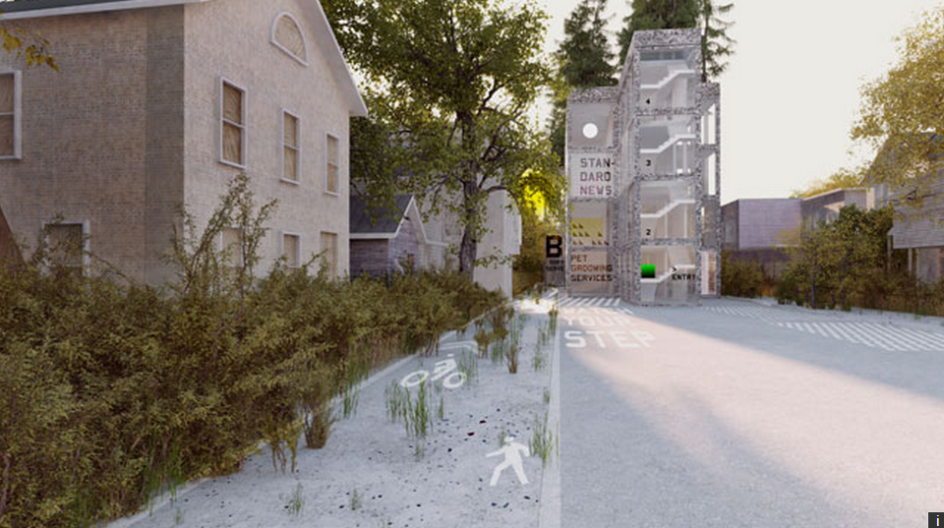
Mixed-use development
Housing
Shops
Services
Offices

Slide 12
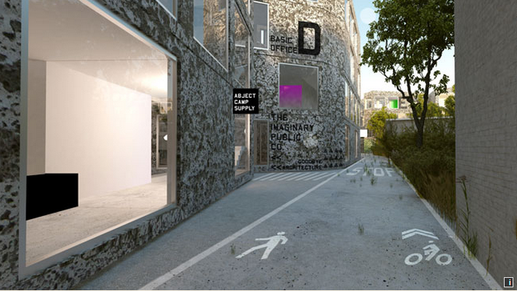
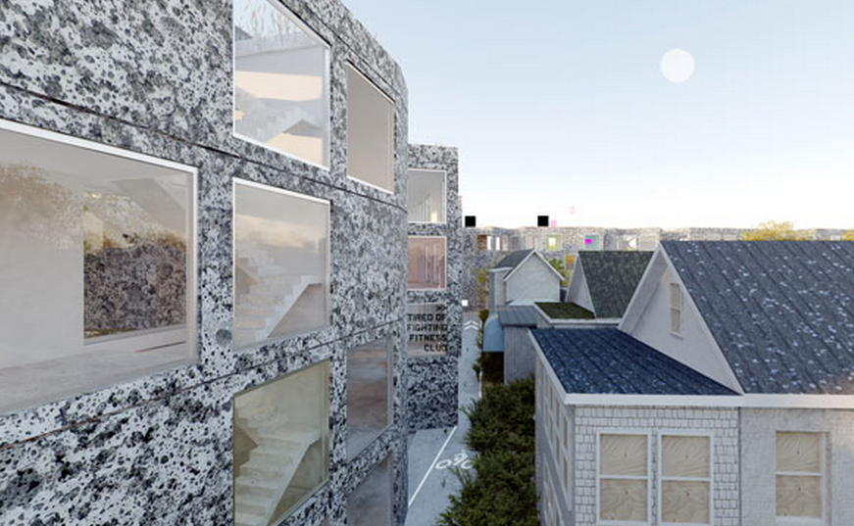
Considering:
municipal budgeting and infrastructure
public health
models of ownership that could promote flexibility and diversity

Slide 13
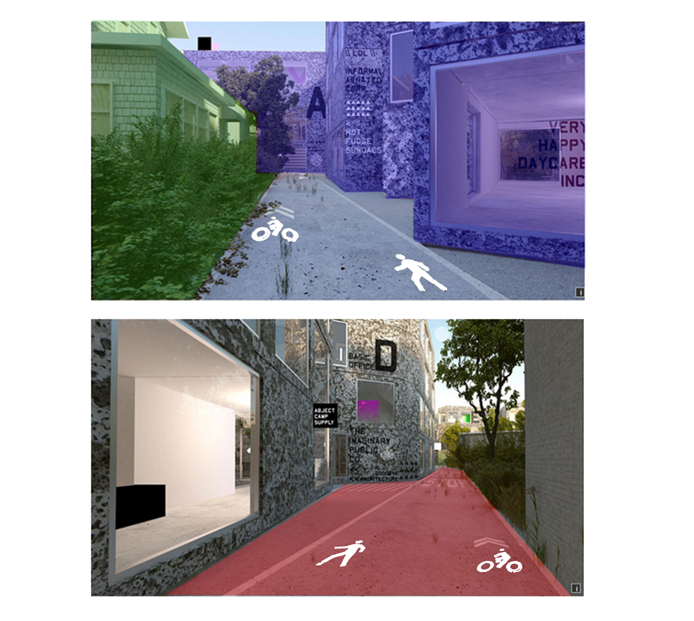

Slide 14
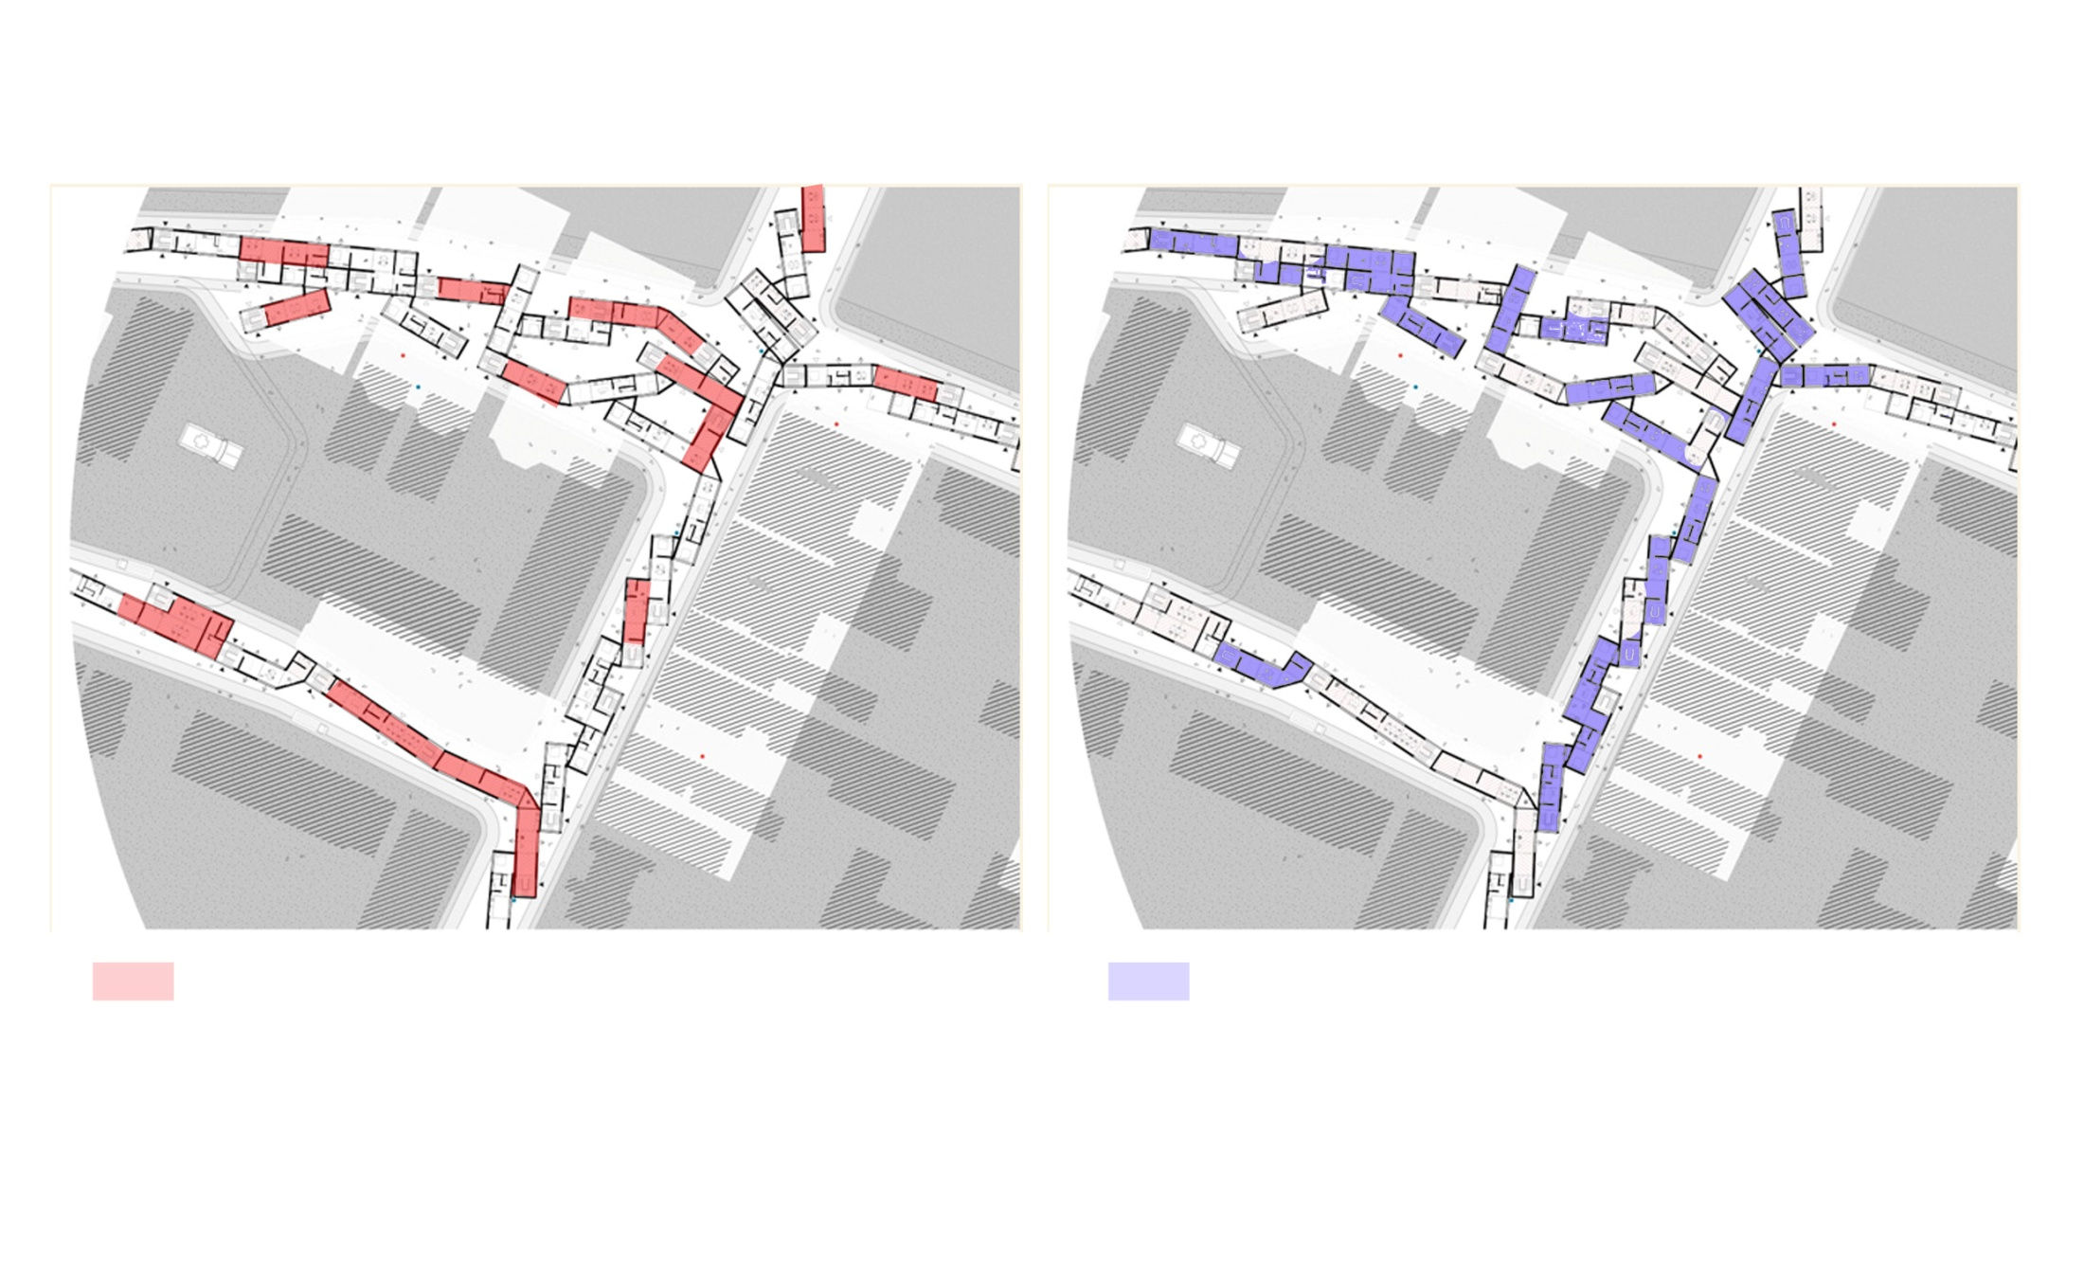
Working space
Housing space

Slide 15
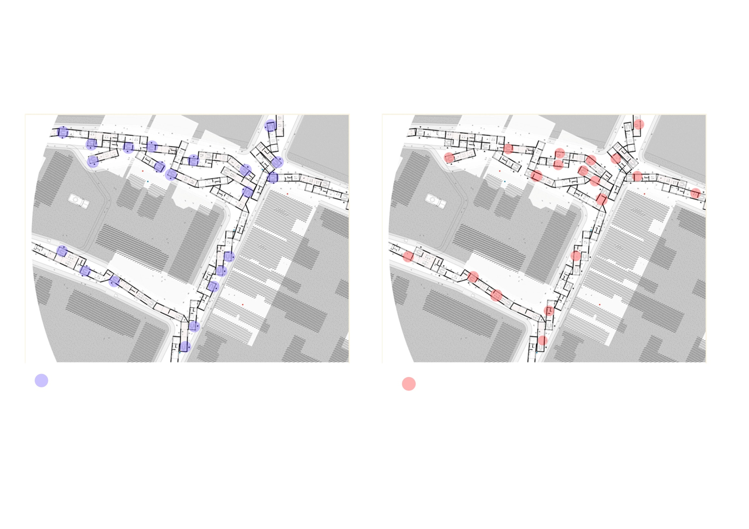
Main building entrance
Ground floor entrance

