Slide 1
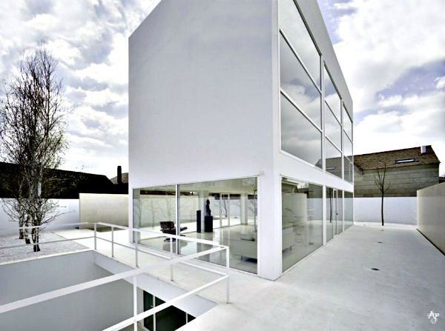
MOLINER HOUSE
Alberto Campo Baeza
Zaragosa, Spain
Ελευθερία Χριστοδούλου
Χριστίνα Μαραγκού
Ραφαέλλα Σπανούδη

Slide 2

Alberto Campo Baeza
Spanish Arcihtect.
Head Professor of Design at the school of architecture of Madrid ESTAM
Practice at Estudio de Arquitectura Campo Baeza
Received many awards for his work.

Slide 3
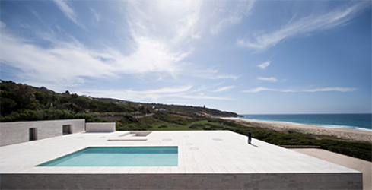
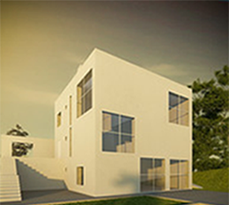
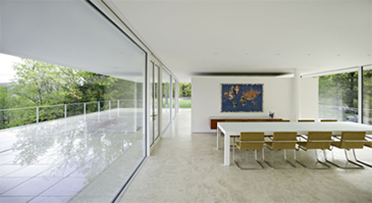
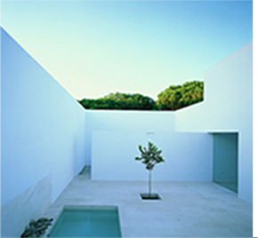
House of Infinite
direct relation with the sky,
houses open to the sky
Gaspar House
huge windows facing south
small windows /orthogonal holes
Olink Spanu
Turegano House
glass panels
raising high walls achieving isolation

Slide 4
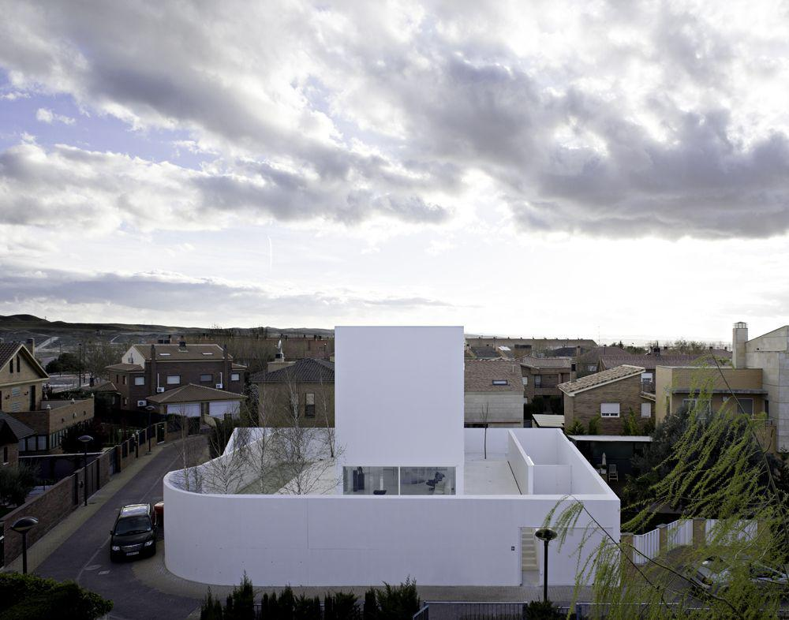
«We raised high walls to create a box open to the sky.»

Slide 5
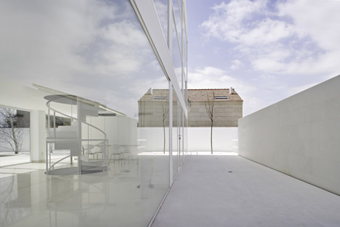
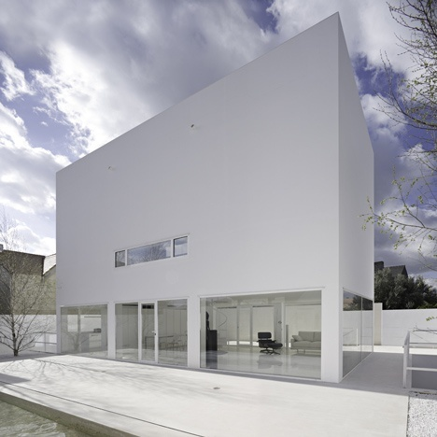
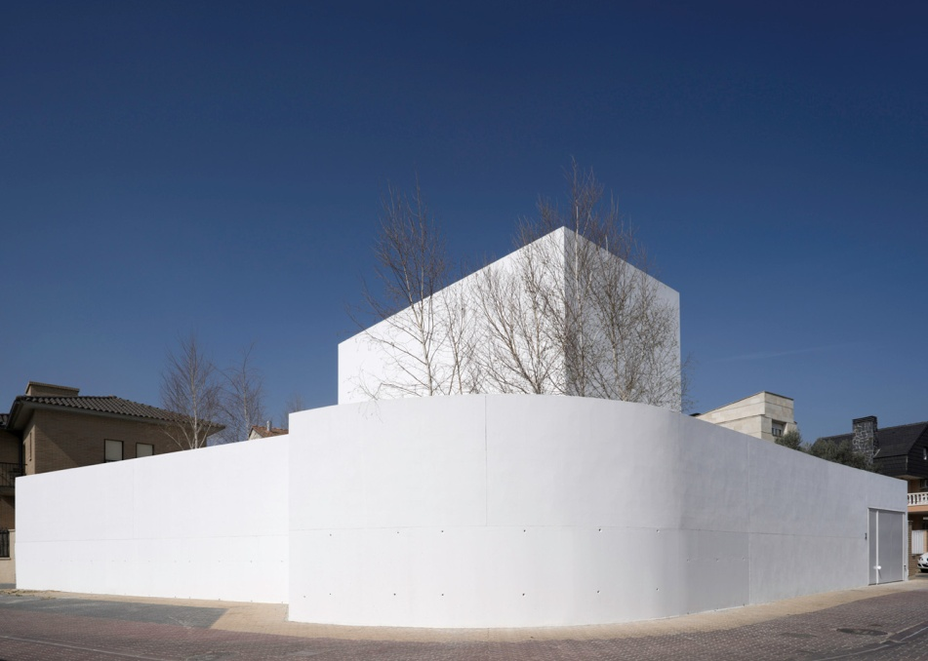
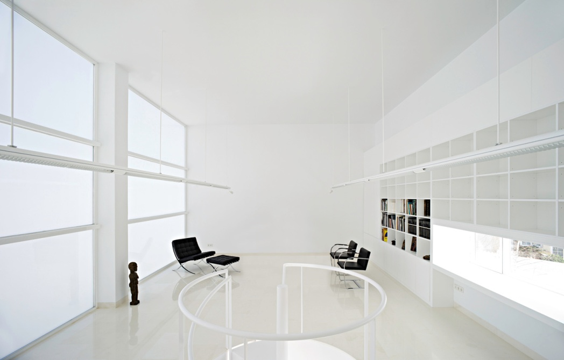

Slide 6
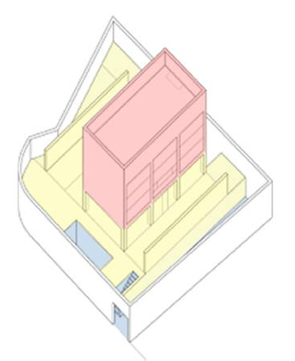
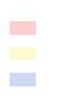
The building consists of three main levels
Upper floor
Ground floor
basement

Slide 7
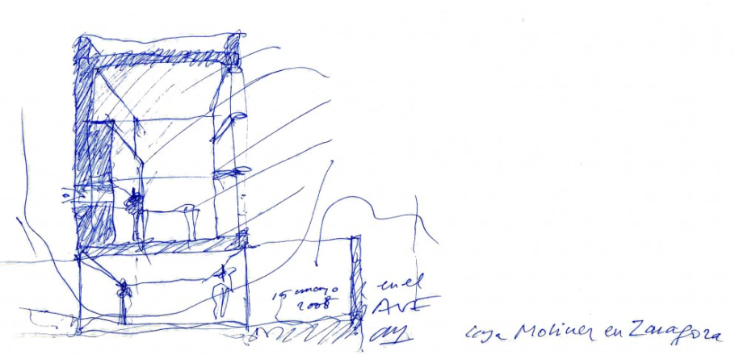
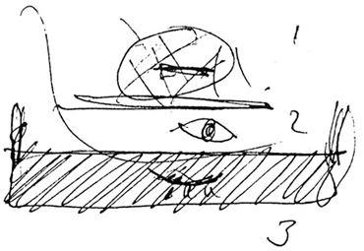
« Dreaming, living, dying. The house of the poet ».
« The highest level for dreaming, the garden level for living and the deepest level for sleeping. »

Slide 8
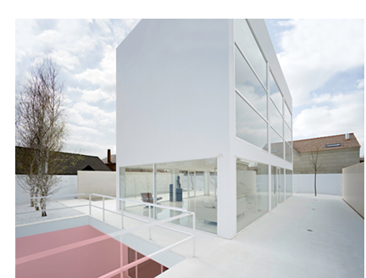
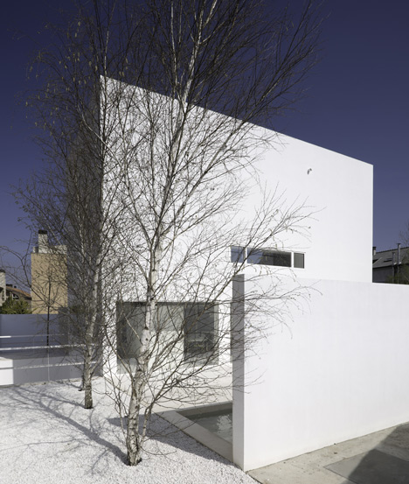
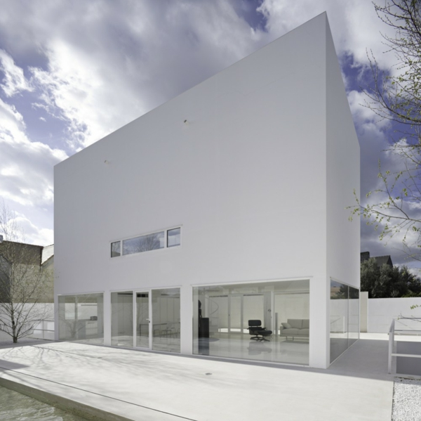
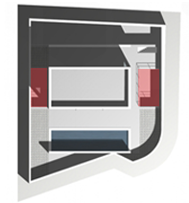
Characteristics of the residence spaces
«For living, the garden with southern light.»

Slide 9
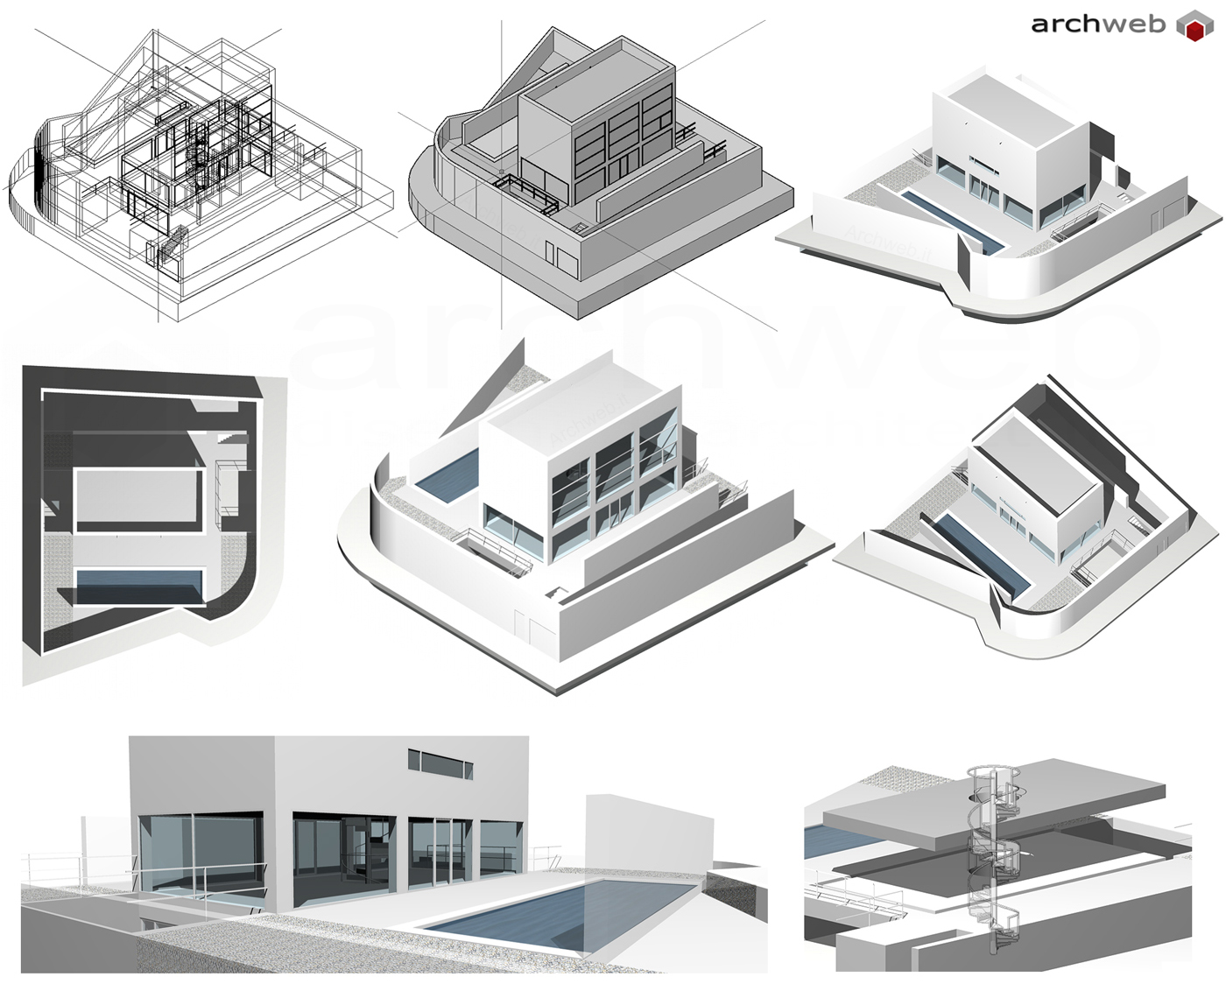
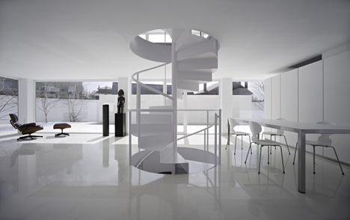
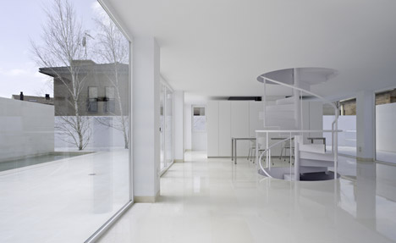
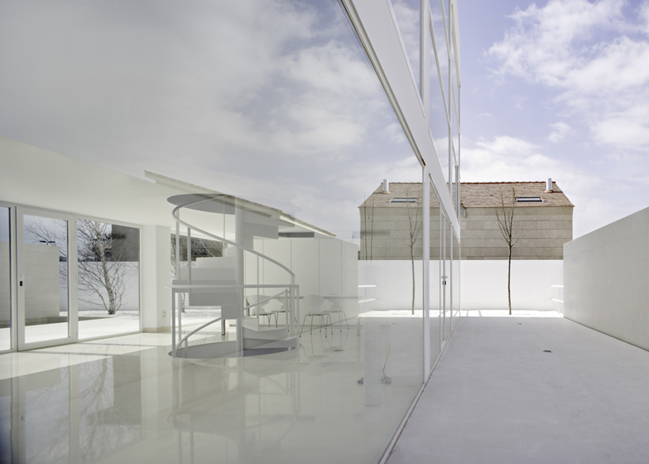
« For living a space that is all garden, with transparent walls that bring together, inside and outside ».

Slide 10
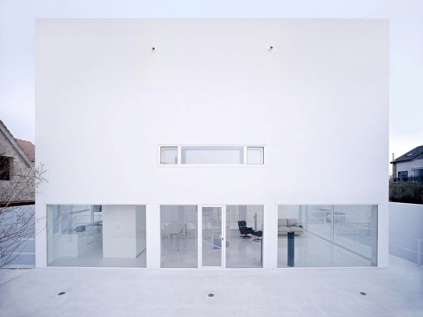
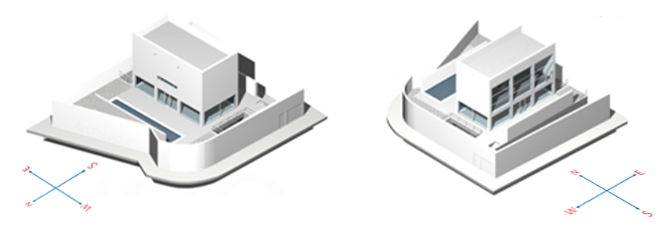
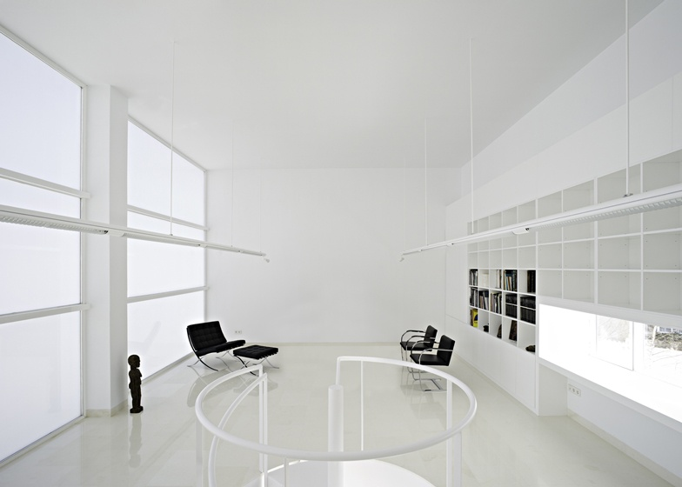
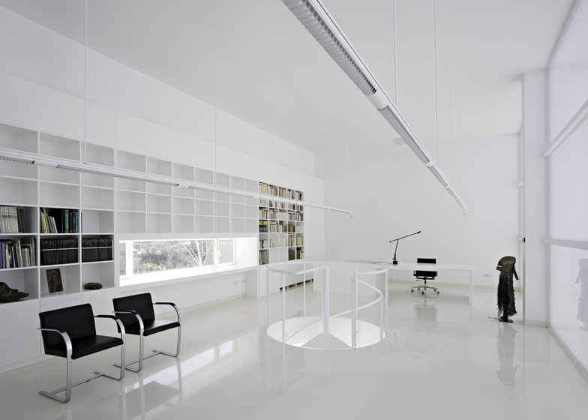
«For dreaming, we created a cloud at the highest point, with northern light diffused through large translucent glass for reading, writing, thinking and feeling ».

Slide 11
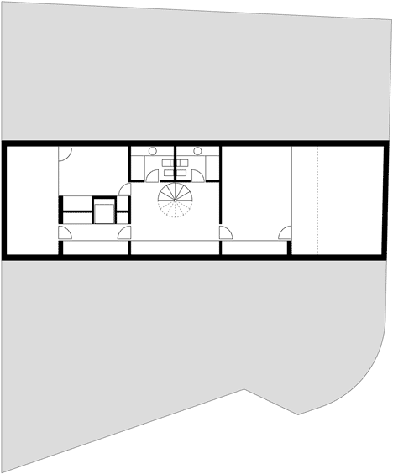
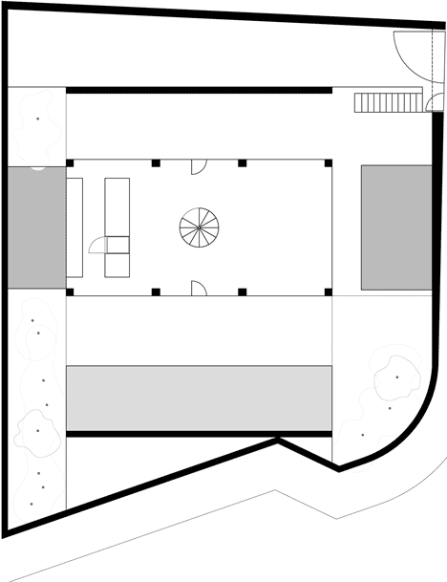
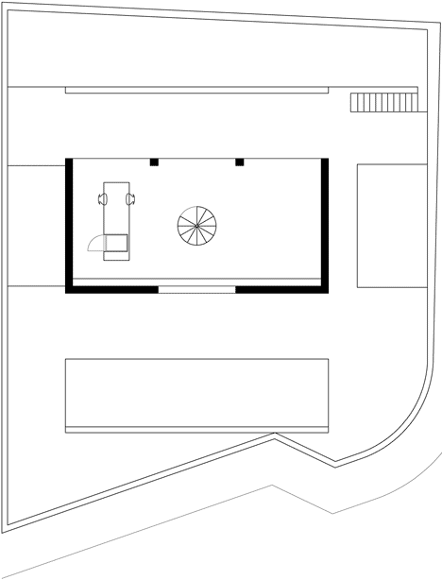
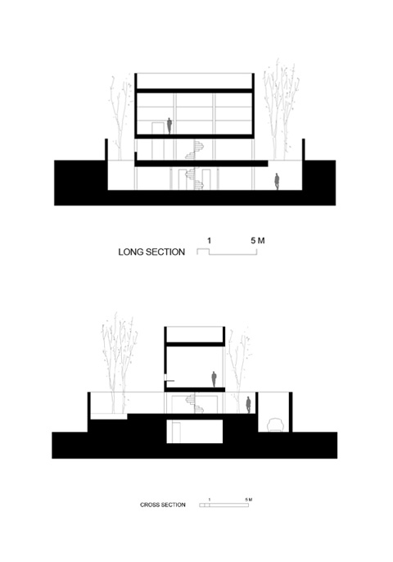
Basement plan
Ground floor plan
First floor plan

Slide 12

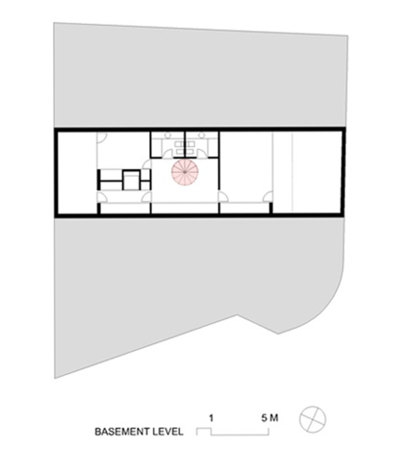

Accessibility
Level deference between the entrance of the site and entrance of the building.
Central spiral staircase

Slide 13
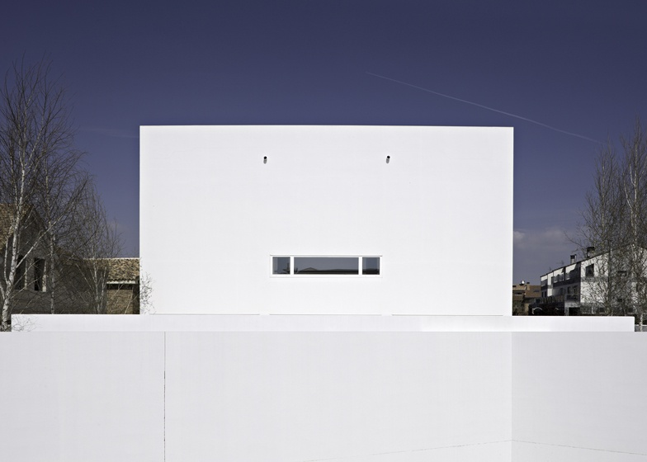
VISIBILITY FROM THE EXTERIOR AND INTERIOR OF THE HOUSE

Slide 14
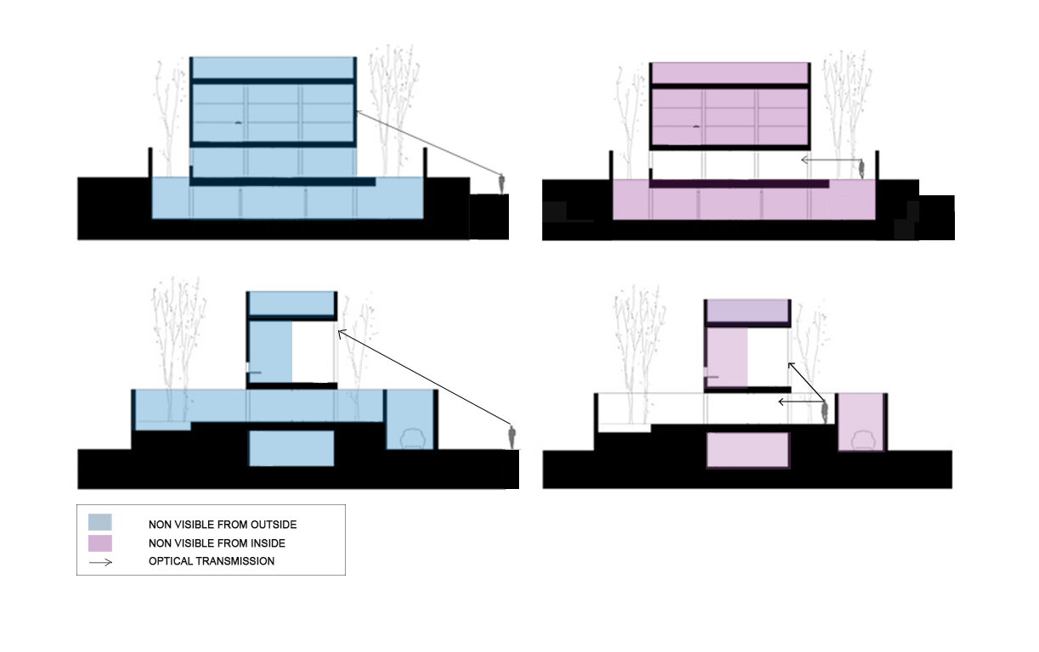
Visibility from the exterior of the house to the interior

Slide 15
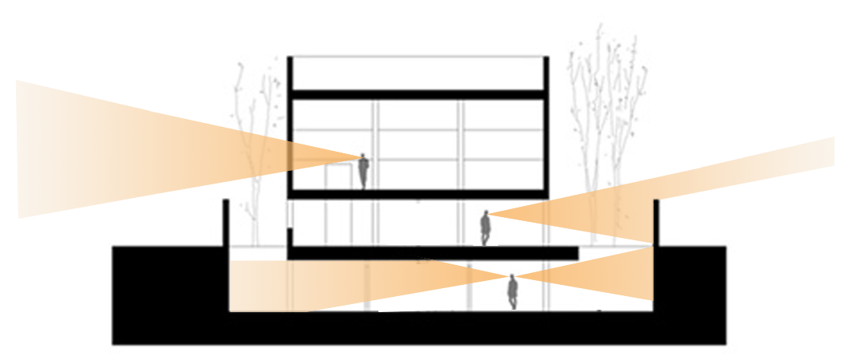
Visibility through house to the exterior
Thank you

Slide 16
The house to be addressed is the Moliner house, located in the city Zaeagkoza in northern Spain.
The architect is Alberto Campo Baeza from Spain.
Some elements that characterize the way that Alberto is his tendency to design white houses.
The Moliner house, was designed for a poet, Luis Moliner Lorente. So the ARCHITECT used poetry approach while planning the house.
The main idea was that the building would become one with the sky.
Τhe house limits environment by 5m height walls. In this way the architect manage to isolate the building of the nearby elements, t
o achieve the union with the sky.
Analysing the house design, we can see that is divided into thee levels. At each level a specific program is identified and target in different
activities and different everyday moments.
The third and lowest level, is addressed to sleep. The second to the daily activities since it constitutes the living room, kitchen and the dining
room.The garden belongs to this level.
The first and highest level is addressed in thought, creation and the work of the poet.
The architect says: ‘’ the highest level for dreaming, the garden level for living and the deepest level for sleeping’’
The characteristics and qualities of spaces of which consists in each level. Concerning 3rd level. This space is semi-basement and is
illuminated only by the light entering from the two holes that exist in the yard - plate on the 2nd level.
Utilised by the user only during sleeping and hygiene since at this level is the master bedroom and toilets.
The house yard is an extension of the second level since is not located at street level and is somehow <built>. There is a pool in the yard and
some deciduous trees.
The internal space of the second level is the central part of the house, as it attracts various family activities since it is along the living room,
dining room and kitchen. The internal space and the second level are open plan, where there are no real walls since the sides are covered
by glass surfaces, which end at the columns.
This is because the architect wanted to achieve the unification of interior with the exterior, ie to abolish the boundaries that separate the
inside from the outside. Also the space is completely perforated in lighting.
The first level where the poet is writes an d which is is the tallest, the architect wanted to resemble cloud, ie the user to feel that is in the sky.
For his reason he create a big opening create a large opening on the south side of the room, which has a direct view of the sky due to the high
that we are. It also allows sunlight to enter in the room with lighting and heating. On the north side of the room there is an oblong opening
which frames the view.

Slide 17
The main concern for the architect is that the user could have continuous view to the sky, in a way that continuous contacts viewing the sky,
so you feel it is framed in. The elements with which the architect achieves that, is that he minimizes the view of other components and isolated
that of the sky. That is because of the high walls around the house. He uses glass surfaces allowing the direct sight cutting across the
boundaries of inside – out and the white colour, neutralizing the building as to the sky. This is also achieved by the different level development.
Regarding the accessibility to the Moliner house, there is an external entrance which leads tp the yard.
The main entrance which leads to he inner of the house is located on the second level and thereby does not contact at street level.
A staircase leads to the yard of the second level. That means that you have access to the building by the middle level, the living room.
Respectively, entering the house, the only access is from the gkaraz- parking. There is no external access into the slipping rooms which
are also located in the third level, one meter under the ground. You can go to the second level through a spiral stair which connects the
three levels. Therefore to move from one level to another you must use the stairs.
The high wall around prevents visual contact or entering the courtyard of the house and isolating from around, give introversion in the
building, since there is no public character. There is no optical transmittance from the outside to the inside, leading passers have no idea
how the house looks if they haven t visited it. Maybe the architect’ s aim was to isolate the building from the surroundings, and so to
exalted and immersed skyward forcefully.
As it regards to the optical, we can observe various combinations arising on whether the user is visible from individuals residing outside the
house or within the space of the yard. Therefore these relations are associated with the position of the user and the observer.
When someone observes the house from outside, he has no visual contact with the interior spaces of the house and the yard, because of
the high 5m wall which surrounds the house. He can only see the highest level, the library, through the large opening in south view.
On the contrary, in the case that someone is in the yard of the residence, this relationship is altered, with the central area the second level,
to be totally visible inside. While the third and deepest level are barely visible, since the observer can look through this and perceive the interior,
from the two holes of the yard that offering lighting. Respectively the first level is barely visible, since the user can not understand what is
happening deeply in the library, because of being close to the building and the first level is high.
In the case of the user and the visibility that has in respect to the surroundings the following are observed. When he is at the lower level,
he has no visual contact with the surroundings. He is as if is immersed in the ground, that is why the architect says «and for sleeping
perhaps dying, the deepest level. The bedroom below as if in a curve».
When the user is on the second level, he has some visual contact with the surroundings, mainly with the sky. There is no direct visual
contact because of the walls around the house, which are in the same height as the second level ends and the fist level starts.
While he is on the first level, the user haw in a way full supervision of the surrounding area through the openings, in both north and south,
as it is at highest level of the surrounding buildings.

